Slide 1
Financial Aid to Support Students
Providing Houston Community College students with access and affordability.
Presented by: Dr. JoEllen Price, Executive Director of FA
Boni Jacobs, Director of FA CS & Processing
Bianca Matlock, Director of FA Operations

Slide 2
Financial Aid Contact Services
In-person at 12 difference locations
Walk-in or Schedule Appointment with a Financial Coach
Call Center
Zoom Lobby
Email
Resolution Center
Drop boxes for submitting documents after hours
Online Services 24/7
PeopleSoft Self-Service and Online Forms
Online Videos
Chatbot – Ask Sunshine
Website

Slide 3
Financial Aid Touchpoints 2022
44,213 students visited the financial aid office in-person
143,778 students received virtual services – Zoom Lobby
64,195 calls were answered from the financial aid call center
10,219 students emailed financial aid and response received
7,628 asked questions using the AI Chatbot
10,454 students watched short financial aid videos on website
721,720 hits on financial aid webpages
2,734 students were serviced at high schools/other events
286 students submitted online resolution center requests
37,779 students submitted online automated forms

Slide 4
HCC Financial Aid Operation Putting students first
Centralized and Automated Processing
Robust communication plan for students and staff
Comprehensive customer service plan
Consistent communications, training and onboarding
Menu of options for students to express concerns
Year-round emergency fund – Sweep to the Rescue
Knowledgeable Financial Coaches
Automated student feedback system
Social media presence
Continuous improvement plans
Data driven decision making
Detailed policies and procedures
SAP Appeal Services and Options

Slide 5
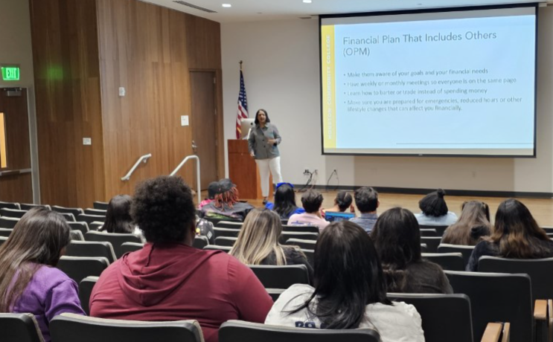
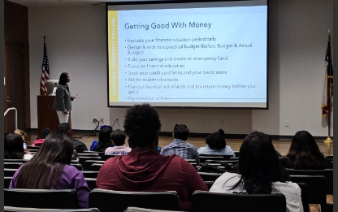
Financial Coaches
Financial Literacy Services
Financial Literacy Group Events
Individual Counseling Sessions
Creating Budgets
Credit Score Awareness
Understanding Asset Accumulation and Net Worth
Money Management
Reduce Debt
Using Student Refunds Wisely

Slide 6
Eagle Promise Program
Qualifications:
Graduate High School in Spring and begin attending HCC in Fall
Texas Resident in HCC taxing district
Submit FAFSA
Complete required documents
Expected Family Contribution (EFC) less than $10,000
Enroll in 9 or more credits beginning in the fall
Commit to complete degree (AA, AS, AAT or AAS) within 3-5 years at HCC
Steps to Apply:
Review qualifications
Submit HCC Admissions Application
Submit FAFSA
Complete Eagle Promise Application and Commitment Form

Slide 7
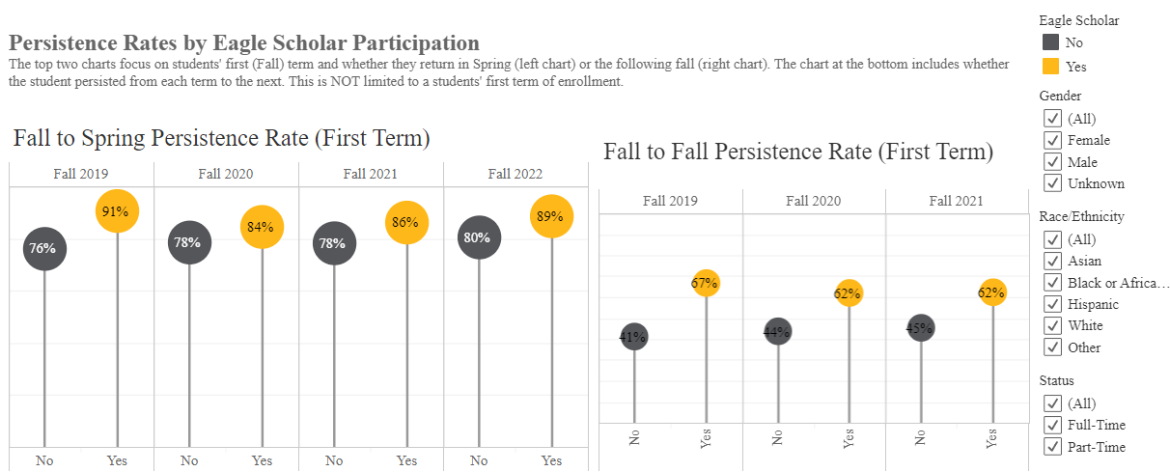
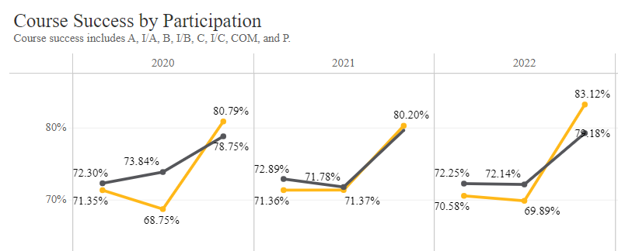
Eagle Promise Program Outcomes – Persistence and Success

Slide 8
HEERF Emergency Aid Funding HCC Allocated $224,239,057
Qualifications:
Available to all enrolled students (ED expanded eligibility)
Priority given to Pell Eligible students (required by law)
Easy online application through self-service
Funds distributed quickly based on student preference
Direct refund or applied to billing account
Funds Distributed April 2020 through April 2023:
HCC Allocation
$87,587,176 student portion
$136,651,881 institutional portion
$105,886,475 in funds distributed to students
$87,587,196 from student portion
$18,299,299 from institutional portion
Total unique count of students - 46,153
Average award per student over 3-year period - $2,294

Slide 9
TEXAS Reskilling Grant HCC Awarded $850,000
Qualifications:
Texas resident for in-state tuition
File FAFSA - Eligible for federal Title IV Aid
Affected by COVID-19
Out of college for over 6 months as of 7/15/2021
Funds distributed 2021 - 2022:
Up to $2,500 per semester for tuition, fees and books/supplies
Funds to students - $850,000
Total unique count of students - 442
Average award per student over 2-year period - $1,923

Slide 10
2021-2022 Financial Aid Funds Distributed
64,952 unique count FAFSA results (ISIRs) received
42,791 total recipients of financial aid funds
21,934 Pell recipients - $77,091,679 – Average $3,514
2,607 SEOG recipients - $1,627,213 – Average $624
9,203 Direct Student Loans - $52,903,179 – Average $5,748
2,622 Texas State Grants - $4,573,275 – Average $1,744
1,483 Institutional & Foundation - $1,759,120 – Average $1,186
930 Private Scholarships - $1,502,687 – Average $1,615
Note:
Payment pause - Default Rate is currently at 0% - Normally at 13%
Total loans borrowed in 2019 was $73,479,884 (12,312 students) with an average of $5,968 per student - 28% reduction in total borrowing

Slide 11
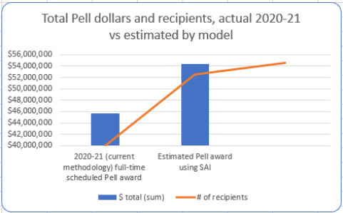
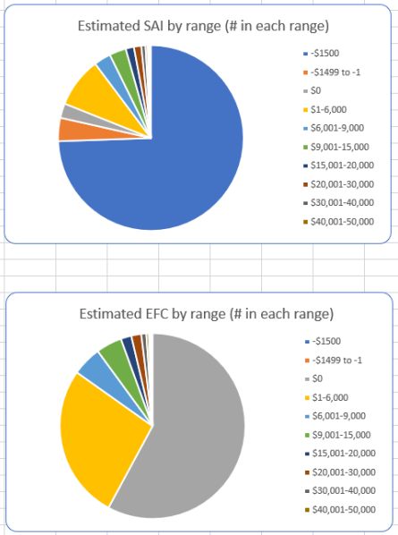
What’s Next FAFSA Simplification 2024-2025 SAI Modeling Tool
FA Delivery System Changes – FAFSA Simplification:
Begins 2024-2025
EFC replaced with SAI
FAFSA questions reduced – 108 to 36
Significant changes to Federal Methodology Formula
HCC students to benefit with greater Pell eligibility

Slide 12
Thank You!
Any Questions?

